Slide 1


IBM Data Science Capstone Project
Chintan Patel
17 Sep, 2022

Slide 2
Outline
Executive Summary
Introduction
Methodology
Results
Conclusion
Appendix

Slide 3
Executive Summary
Summary of Methodologies
Data Collection
Data Wrangling
EDA with Data Visualization
EDA with SQL
Building an Interactive Map with Folium
Building a Dashboard with Plotly Dash
Predictive Analysis (Classification)
Summary of all Results
Exploratory Data Analysis of Results
Interactive Analysis Demonstration in Screenshots
Predictive Analysis Results

Slide 4
Introduction
Project Background and Context
The commercial space age has arrived and companies are making space travel possible and affordable. Virgin Galactic, RocketLab, Blue Origin and SpaceX dominate the industry, providing suborbital spaceflights, satellites, satellite internet and reusable rockets. Possibly the most successful of these companies is SpaceX, with relatively inexpensive rocket launches, advertising Falcon 9 rocket launches at a cost of 62 million dollars. Compared to the competition charging 165 million dollars and upwards, SpaceX dominate the market by saving on the first stage of launch by recovering (or reusing) the first stage.
This crucial first step is vital to SpaceX’s success and we will therefore purpose to predict the likelihood of the Flacon 9 landing successfully. If the success of the first stage can be predicted with a high-level of accuracy, we can predict the cost of a launch. This information can be utilized by competing companies seeking to contend in this field.
Problems we will Seek to Answer
The price of each launch
Correlations between rocket attributes and successful landings
Conditions that result in successful landings

Slide 5

Section 1

Slide 6
Methodology
Executive Summary
Data collection methodology:
SpaceX API
Web Scraping from Falcon 9 and Falcon Heavy Launches Records - Wikipedia
Perform data wrangling
Convert outcomes into Training Labels with the booster successfully/unsuccessfully landed
Perform exploratory data analysis (EDA) using visualization and SQL
Perform interactive visual analytics using Folium and Plotly Dash
Perform predictive analysis using classification models
Find the most effective hyperparameters for SVM (Support Vector Machines), Classification Trees and Logistic Regression models

Slide 7

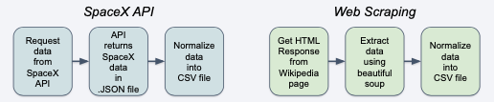
Data Collection
The data collection process is a conglomeration of both API (Application Programming Interface) requests from the SpaceX API and web scraping from the SpaceX Wikipedia page Falcon 9 and Falcon Heavy Launches Records
SpaceX API Data Columns:
Flight Number, Date, Booster Version, Payload Mass, Orbit, Launch Site, Outcome, Flights, Grid Fins, Reused, Legs, Landing Pad, Block, Reused Count, Serial, Longitude, Latitude
Web Scraping:
Wikipedia Web Scrape Data Columns: Flight No., Launch Site, Payload, Payload Mass, Orbit, Customer, Launch Outcome, Version Booster, Booster Landing, Date, Time

Slide 8
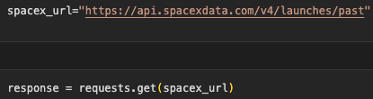
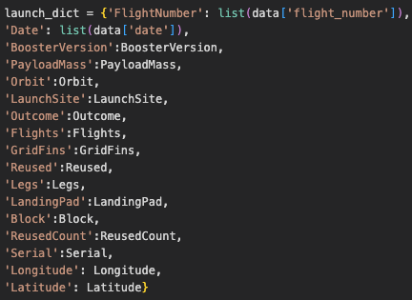
Data Collection – SpaceX API
Request Rocket Launch Data from Space X:
Normalize response to a JSON. file and convert the JSON result into a data frame:
Employ get functions to clean data:
GITHUB LINK
Construct a dataset using the data obtained and combine the columns into a dictionary:
Filter the data frame and export as a CSV

Slide 9
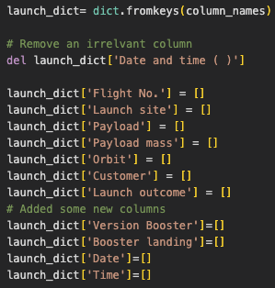
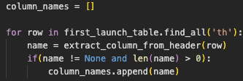
Data Collection - Scraping
Retrieve response from HTML:
Create a BeautifulSoup object:
Find all tables and assign the result to a List:
Extract Individual column name
GITHUB LINK
Create an Empty Dictionary with Keys
Create a Data Frame by parsing the Launch HTML Tables
Create a Data Frame and Export it as a CSV

Slide 10
Data Wrangling
There are several different cases where the booster did not land successfully. Other times, a landing was attempted but failed due to an accident:
True Ocean: The mission result has successfully landed in a specific area of the ocean
False Ocean: The mission outcome has not resulted in a successful landing in an area of the ocean
True RTLS: The mission result successfully landed on the ground pad
False RTLS: The mission outcome has not resulted in a successful landing on the ground ship
True ASDS: The mission result has successfully landed on the drone ship
False ASDS: The mission outcome has not resulted in a successful landing on the drone ship
Converting the Results into Training Labels
1 = Successful
0 = Failure
GITHUB LINK

Slide 11
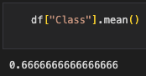

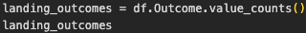
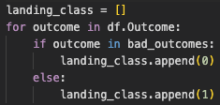
Data Wrangling
Calculating the number of launches at each site
Calculating the number and occurrence of each orbit
Calculating the number and occurrence of mission outcome
per orbit type
Creating a landing outcome from the outcome column
GITHUB LINK
Calculating the success rate for every landing in the dataset
Export the data to CSV

Slide 12
EDA with Data Visualization
Scatter Chart
Flight Number vs. Launch Site
Payload vs. Launch Site
Flight Number vs. Orbit Type
Pay Load vs. Orbit Type
A scatter plot demonstrates how one variable is affected by another variable. This interrelationship is known as correlation and is generally composed of large data sets.
Bar Chart
Orbit Type vs. Success Rate
A bar chart allows us to compare datasets and allows for simple visual evaluation. The first axis represents a data category, while the other axis represents a discrete value. The purpose of the bar chart is to display the relationship between the two axis
Line Chart
Years vs. Success Rate
A line chart displays data variables and trends, helping us predict the results of data may have not yet been recorded.
GITHUB LINK

Slide 13
EDA with SQL
Loading the Data Set into the Corresponding Table in the Db2 Database, Executing SQL Queries to Answer the Following Questions:
Displaying the names of the unique launch sites in the space mission
Displaying 5 recordings where launch sites begin with the string ‘CCA’
Displaying the total payload mass carried by boosters launched by NASA (CRS)
Displaying average payload mass carried by booster version F9 v1.1
List the date when the first successful landing outcome on the ground pad was achieved
List the names of the boosters which have success on the drone ship and have a pay load mass greater than 4000 and less than 6000
List the total number of successful and unsuccessful mission outcomes
List the names of the booster versions that have carried the maximum payload mass
List the failed landing outcomes on the drone ship, their booster versions and launch site names for the year 2015
Ranking the count of landing outcomes (drone ship failure or ground pad success) between the dates 04/06/2010 and 20/03/2017, in descending order
GITHUB LINK

Slide 14
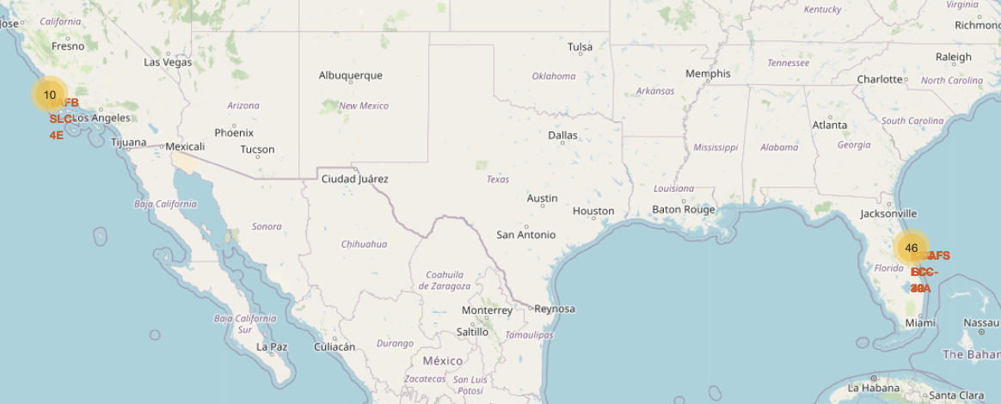
Build an Interactive Map with Folium
Objects Created and Added to a Folium Map:
Markers that show all launch sites on a map
Markers that show the successful and failed launches for each site on the map
Lines that show the proximities between launch sites
By Adding these Objects the Following Geographic Patterns about Launch Sites are Found:
Launch sites are in close proximity to railways
Launch sites are in close proximity to highways
Launch sites are in close proximity to coastlines
Launch sites keep specific distance from cities
GITHUB LINK

Slide 15
Build a Dashboard with Plotly Dash
The Dashboard Application Contains a Pie Chart and a Scatter Point Chart:
Pie Chart
For showing total success launches by sites
This chart is useful to indicate a successful landing distribution across all launch sites or to indicate the success rate of individual launch sites
Scatter Chart
For showing the relationship between Outcomes and Payload Mass (Kg) by different boosters
The scatter chart has 2 inputs: All sites/individual sites and payload mass on a slider between 0 and 10000 kg
The scatter chart helps estimate how each launch site, payload mass and booster version categories determine a successful launch
GITHUB LINK

Slide 16
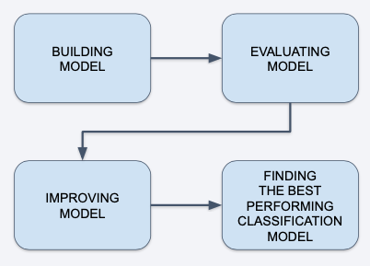
Predictive Analysis (Classification)
First, We Explore Data Analysis and Determine Training Labels
Create a column for class
Standardize the data
Split into training data set and test data set
Find the Best Hyperparameter for SVM, Classification
Trees and Logistic Regression
Find the Method that performs best using test data
GITHUB LINK

Slide 17
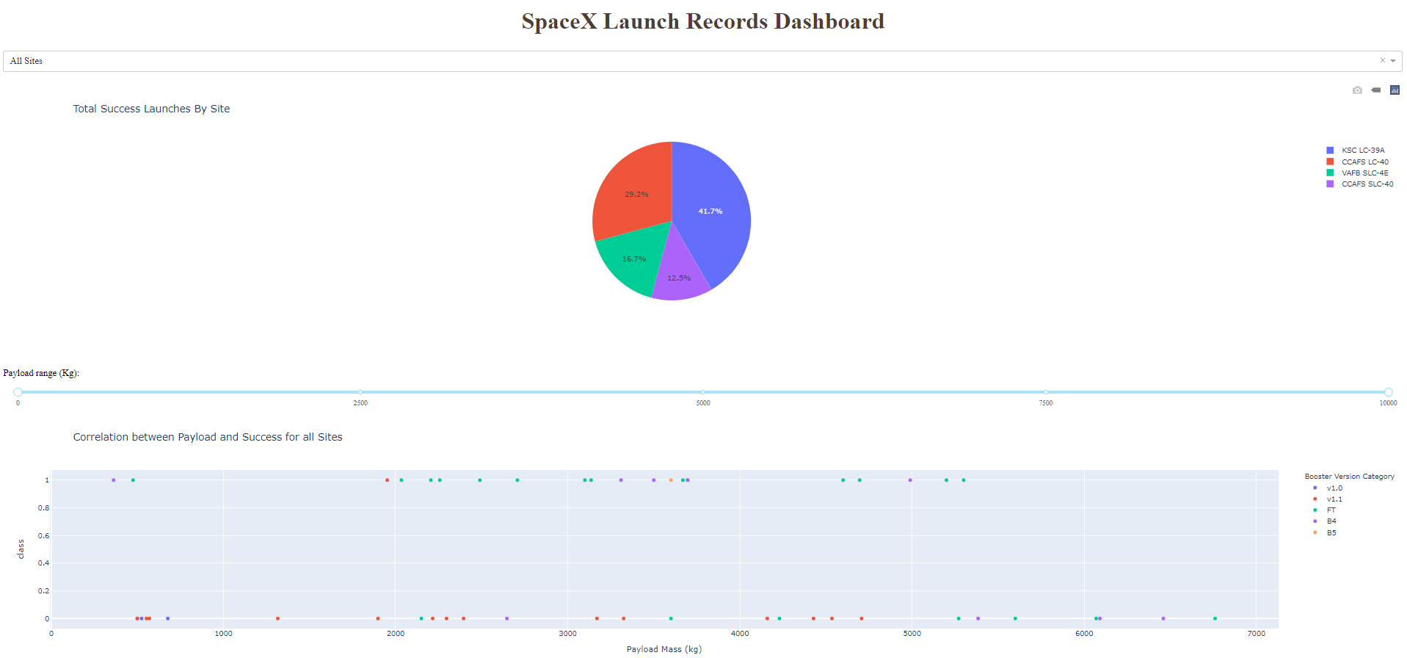
Results
The Image Shows a Preview of the Dashboard made with Plotly Dash
The results of EDA with Visualization, EDA with SQL, the Interactive Map with Folium will be Included in the Upcoming Slides
The Four Methods Mentioned Above return an Accuracy of 83% for the Test Data

Slide 18

Section 2

Slide 19
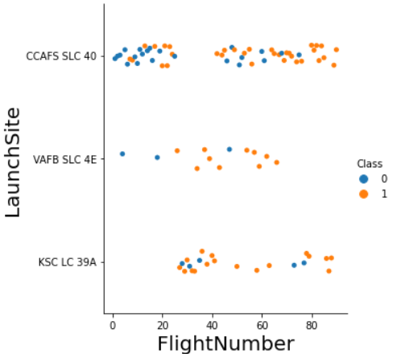
Flight Number vs. Launch Site
Class 0 (Blue):
Represents an unsuccessful launch
Class 1 (Orange):
Represents a successful launch
The figure presented demonstrates that the success rate increased as the number of flights increased
The success rate increases drastically at the 20th flight

Slide 20
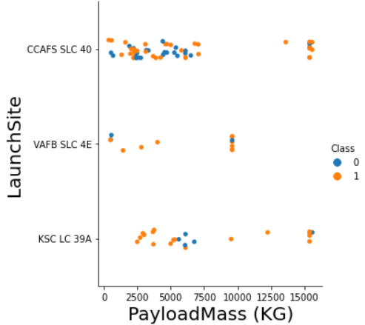
Payload vs. Launch Site
Class 0 (Blue):
Represents and unsuccessful Launch
Class 1 (Orange):
Represents a successful launch
While the larger pay load mass would seem to indicate a higher rocket success rate there is no clear correlation between a successful launch and the pay load mass (kg)

Slide 21
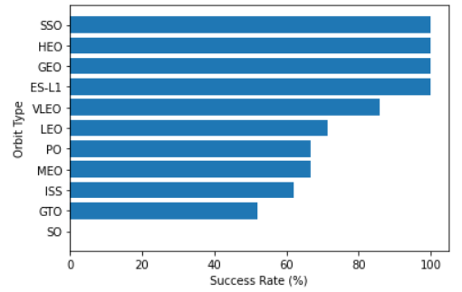
Success Rate vs. Orbit Type
Orbit Types:
SEO (Sun-Synchronous Orbit), HEO (Highly Elliptical Orbit), GEO (Geostationary Orbit), ES-L1 (Lagrangian) have 100% success rate
The success rate of the GTO (Geostationary Transfer orbit) type has a 50% success rate
The lowest success rate is the type SO Orbit

Slide 22
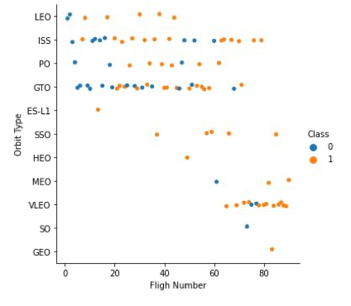
Flight Number vs. Orbit Type
Class 0 (Blue):
Represents an unsuccessful launch
Class 1 (Orange):
Represents a successful launch
There appears to be a correlation between launch outcome and flight number
GTO (Geosynchronous Transfer Orbit) is an exception, with no demonstrable correlation between flight number and success rate
VLEO (Very Low Earth Orbit) demonstrates the highest success rate and is used in the most recent launches

Slide 23
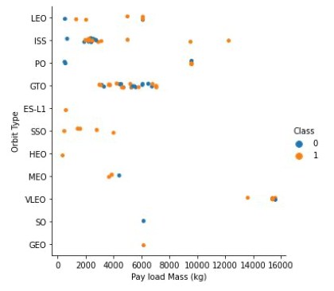
Payload vs. Orbit Type
Class 0 (Blue):
Represents an unsuccessful launch
Class 1 (Orange):
Represents a successful launch
LEO (Low Earth Orbit) and ISS (International Space Station Orbit) successful landings are associated with lighter Pay Load Mass (Kg)
GTO (Geosynchronous Transfer Orbit) is difficult to distinguish as the data is evenly spread between blue and orange

Slide 24

Launch Success Yearly Trend
The success rate of rocket launches has continued to increase from 2013 till 2017
A sharp decline in success rate is observed from 2017 to 2018
The success rate is then seen increasing to an all time high in 2019 and declines steadily from then
To date, a success rate of roughly 80% is observable

Slide 25
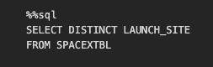
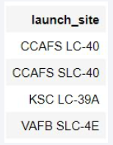
All Launch Site Names
The SQL DISTINCT clause is used for this query to extract unique values pertaining to the Launch Sites from the SpaceX table
This query produces four unique launch sites:
CCAFS LC-40
CCAFS SLC-40
KSC LC-39A
VAFB SLC-4E

Slide 26
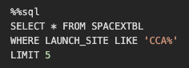
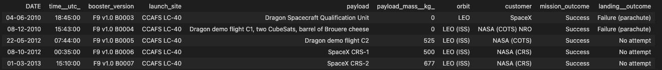
Launch Site Names Begin with 'CCA'
SELECT * SQL query is used to display the site names from the SpaceX records
LIMIT 5 is employed to present the first five launch sites
The LIKE operator and ‘CCA%’ are called to present the launch sites

Slide 27
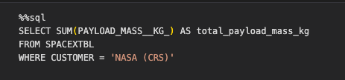

Total Payload Mass
Employing the SUM() function to calculate the sum of column PAYLOAD_MASS_KG from the SpaceX table
The WHERE clause will filter the dataset to perform calculations where the customer is NASA (CRS)
RESULT:

Slide 28
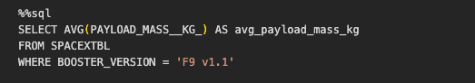

Average Payload Mass by F9 v1.1
Employing the AVG() function we will calculate the average value of the column PAYLOAD_MASS_KG
The WHERE clause will filter the dataset to perform calculations only if Booster_version is F9 v1.1
RESULT:

Slide 29

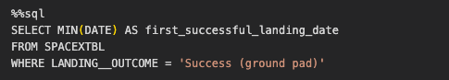
First Successful Ground Landing Date
Employing the MIN() function to calculate the earliest date in the column DATE
The WHERE clause will filter the dataset to perform calculations where the Landing_outcome is successful with regards to the ground pad
RESULT:

Slide 30
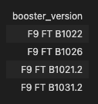
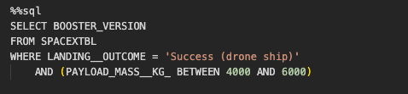
Successful Drone Ship Landing with Payload between 4000 and 6000
Employing the SELECT() clause to filter results specifically to BOOSTER_VERSION
The WHERE clause will filter the dataset to produce results where the Landing_outcome is ‘success’ according to the drone ship
The AND operator will specify results where the condition is the PAYLOAD_MASS_KG is between 4000 and 6000
RESULT:

Slide 31
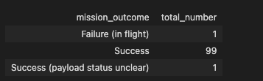
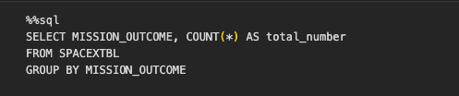
Total Number of Successful and Failure Mission Outcomes
Employing the COUNT() function to calculate the total number of columns
The GROUP BY statement will filter the dataset into summary rows for rows that contain the same values in order to find the total sum in each Mission_outcome
RESULT:
SpaceX has successfully completed close to 99% of its missions

Slide 32
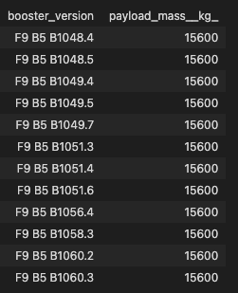
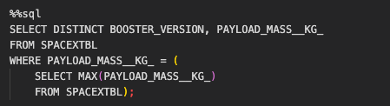
Boosters Carried Maximum Payload
In this section we will employ a subquery to determine the maximum value of the payload. This will be done using the MAX() function
Secondly, we will limit the dataset to search if PAYLOAD_MASS_KG is the maximum value of the payload
RESULT:
Version F9 B5 B1048.4 – F9 B5 B1060.3 boosters are capable of carrying the maximum payload

Slide 33
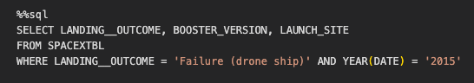

2015 Launch Records
Using the WHERE clause, we will filter that dataset to perform a search if the Landing_outcome is Failure with regards to the drone ship
The AND operator will display a record if the additional year is 2015
In 2015, there was one landing failure on drone ships

Slide 34
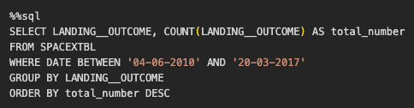
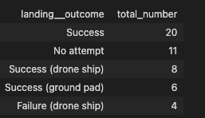
Rank Landing Outcomes Between 2010-06-04 and 2017-03-20
The COUNT function selects the landing outcomes, while the WHERE clause will filter the dataset to conduct a search between 04/06/2010 and 20/03/2017
The ORDER BY clause was selected to sort the total records by number of landings – sorted in descending order
There is minimal deviation in results between the number of successful and unsuccessful launches between 04/06/2010 and 20/03/2017

Slide 35

Section 3

Slide 36

SpaceX Launch Site Locations
The Folium map displays all SpaceX launch sites
It is evident that all launch sites are coast-bound

Slide 37

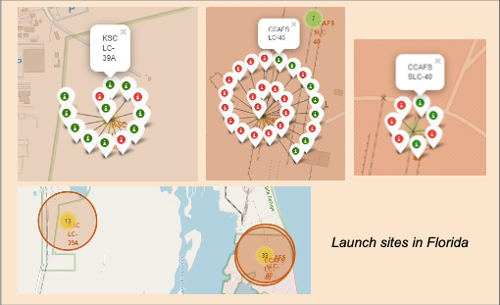
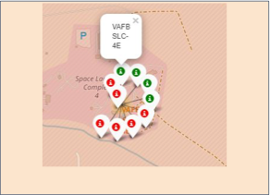
Launch Site Outcomes
Successful landings (green):
Failed landings (red):

Slide 38
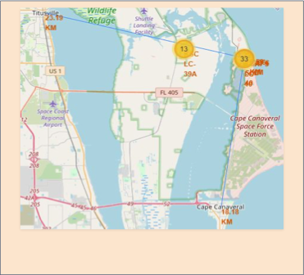
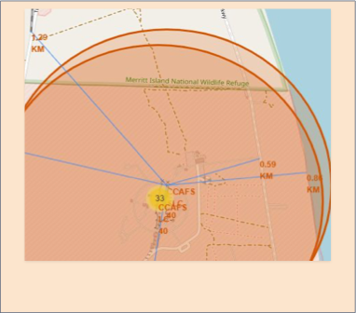
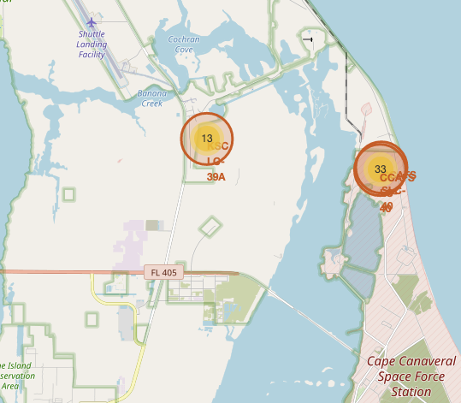

Launch Site Proximity
Launch sites are predominantly close to railways and highways. It may be hypothesized that this is due to ease of transportation for equipment and personnel
Proximity to the coastline and a safe distance from cities allows for safe launch without compromising the safety of citizens located in the nearby towns and cities.

Slide 39

Section 4

Slide 40
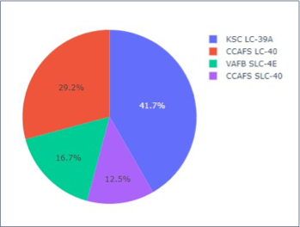
Successful Launches – All Sites
KSLC - 39A has the highest success rate among all sites
VAFB SLC-4E has the least success. This is likely due to:
A small data sample
It is the only site located in California, hence the West Coast may pose more difficulty than the East Coast, due to unknown factors

Slide 41
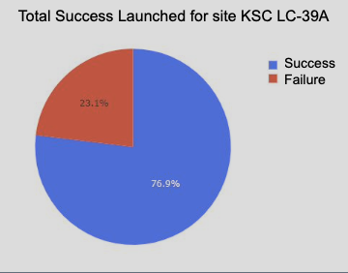
Laugh Site – Highest Success Rate
KSLC – 39A holds the highest success rate:
10 Successful Landing (76.9%)
3 Landing Failures (23.1%)

Slide 42
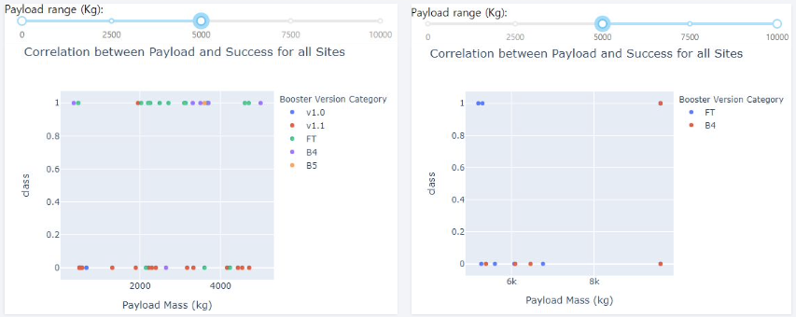
Payload and Launch Outcome Scatter Plot
The following graphs illustrate that the launch success rate (class 1) – for low weighted payloads (0 – 5000kg) – is higher than that of heavy weighted payloads (5000 – 10000 kg)

Slide 43

Section 5

Slide 44
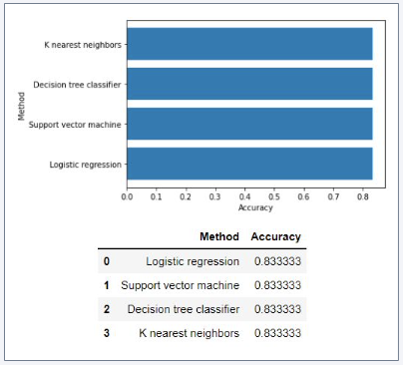
Classification Accuracy
The test set produced as accuracy of approximately 83.33%
Due to the small test set (18) more data is needed to determine the ideal model

Slide 45
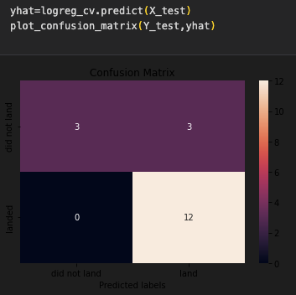
Confusion Matrix
As all models were used for the same test set, the confusion matrix is the same for all models
However, the confusion matrix for the decision tree demonstrates that the classifier can distinguish the different classes
False positives remain a concern as unsuccessful landings may be marked as successful by the classifier
Ultimately, these models predict successful landings

Slide 46
Conclusions
As the number of flights increase, the success rate increased
Recently this number has exceeded 80%
Orbital types SSO, HWO, GEO and ES-L1 have the highest success rate
Launch success rate started to increase in 2013 till 2020
KSLC-39A has the highest number of successful launches and the predominant success rate among all sites
The decision tree classifier has proved to be the most successful model algorithm for this task
The success rate of low weighted payloads is higher than heavy weighted payloads
All models have the accuracy of 83.33%, though it would appear that more data is needed to determine the optimal model as a small data size was utilized

Slide 47
Appendix
Coursera Applied Data Science Cap Stone Course URL
Visual Studio Code
PyCharm CE
GITHUB PROJECT LINK

Slide 48


